Slide 1

NATIONAL UNIVERSITY OF MODERN LANGUAGES
Faculty of Engineering and Computing
Department of Software Engineering

Slide 2

SOFTWARE DESIGN AND ARCHITECTURE
LECTURE NO. 2
Introduction to Software Engineering Design
Course Instructor: | Mr. Ahsan Arif
 | Lecturer Department of Software Engineering NUML Islamabad
Date: September 18, 2024
Software Engineering Design: Theory and Practice

Slide 3
LECTURE CONTENTS
Introduction to Software Design with UML
  Conceptual Overview
  What is UML?
    Classification of UML diagrams
  Why Study UML?
  The UML’s Fundamentals
  Designing the Architecture
    The 4 + 1 View Model
      User View
      Process View
      Physical View
      Development View
      Logical View
Date: September 18, 2024
Software Engineering Design: Theory and Practice

Slide 4
CONCEPTUAL OVERVIEW
Communication is an essential, critical skill for engineers.
  Throughout a project’s life-cycle, designers spent a great deal of time and effort communicating with other members (stakeholders) of the project.
  We learn different types of programming languages such as C, C++, Python, Java, etc.
  UML is very different from programming languages
    Visual language
    Helps us understand any system
  Objective/Aim/Goal: UML is to define a standard way to visualize the way a system has been designed.
A picture is worth a thousand words…
Date: September 18, 2024
Software Engineering Design: Theory and Practice

Slide 5

THE UNIFIED MODELING LANGUAGE (UML)
UML comes from Rumbaugh, Booch, and Jacobson (the three amigos) who combined efforts to standardize on one modeling language.
The goals of the unification project were specified by Booch, Rumbaugh, and Jacobson as follows:
  To model systems, from concept to executable artifact, using object-oriented techniques.
  To address the issues of scale inherent in complex, mission-critical systems.
  To create a modeling language usable by both humans and machines.
Formally, UML can be defined as a visual language for specifying, analyzing, and documenting design elements essential for modeling the dynamic and static aspects of software systems before construction.
Date: September 18, 2024
Software Engineering Design: Theory and Practice
Notes:
The first efforts focused on unifying three popular modeling methods:
The Booch method, by Grady Booch
The object-oriented software engineering method (OOSE), by Ivar Jacobson
The object modeling technique (OMT) by James Rumbaugh
The UML is a language for
Visualizing
Specifying
Constructing
Documenting

Slide 6
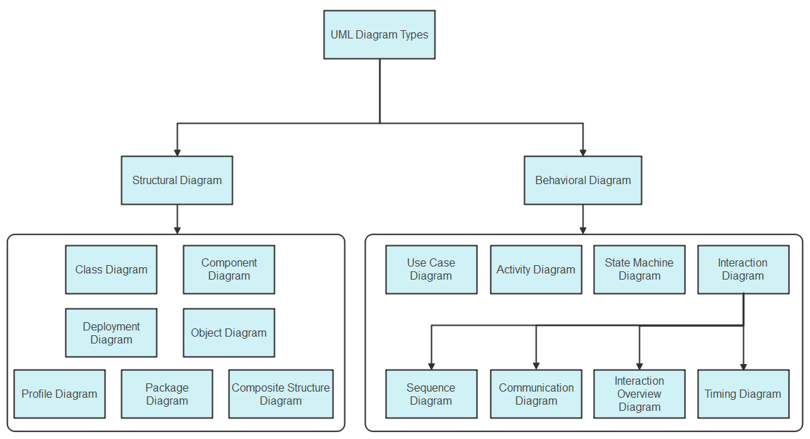
CLASSIFICATION OF UML DIAGRAMS
Officially, UML Structural Diagrams
  Concerned with capturing and specifying static elements (like classes, objects, relationships) and their interrelationships required for supporting the solution to a given problem, within a given context.
Behavioral Diagrams
  Concerned with capturing and specifying the dynamic behavior and the inherent complexities present in the behavioral aspects of software systems.
Date: September 18, 2024
Software Engineering Design: Theory and Practice
Notes:
The first efforts focused on unifying three popular modeling methods:
The Booch method, by Grady Booch
The object-oriented software engineering method (OOSE), by Ivar Jacobson
The object modeling technique (OMT) by James Rumbaugh
The UML is a language for
Visualizing
Specifying
Constructing
Documenting
Structural: This aspect focuses on representing and defining static elements (like classes, objects, relationships) and how they are interconnected to support solving a specific problem within a particular context. It deals with the system's architecture and organization.
Behavioral: This aspect deals with capturing and specifying the dynamic behavior of the software system, including its inherent complexities. It involves describing how different components interact and behave over time, depicting processes, actions, and events within the system.

Slide 7
WHY STUDY UML?
UML 2.3 provides 14 types of diagrams that can be used for modeling both Structural and Behavioral
Because projects vary drastically, not all diagrams are used in every project.
  Designers select the ones that can help them effectively model the system.
Therefore, the study of UML becomes important so that the modeling capabilities of particular diagrams are well understood and applied in practical efforts.
The two main reasons for studying UML include
  The UML enhances system analysis and specification.
  The UML enhances communication.
Date: September 18, 2024
Software Engineering Design: Theory and Practice

Slide 8
THE UML’S FUNDAMENTALS
The UML is an extensible and flexible language that can be used to model almost any aspect of today’s modern software systems.
  However, the fundamental building blocks are well defined and must be understood before applying UML effectively.
UML’s building blocks are grouped into:
  Classifiers (e.g., classes, interfaces, components)
  Structural things that represent conceptual or physical elements of a model.
  They are typically the main elements in UML diagrams.
  Each type of UML diagram, uses specific type of classifiers, so that not all classifiers are relevant to all UML diagrams.
  Relationships (e.g., associations, dependencies, generalizations)
  Defines and provides visualization of the interconnections that exists among classifiers.
  Enhancing features (e.g., stereotypes, tagged values, constraints)
  Provides flexibility that allow designers to enhance and evolve modeling capabilities so that they become appropriate for particular systems.
Date: September 18, 2024
Software Engineering Design: Theory and Practice
Notes:
Summary of UML Building Blocks:
Classifiers: Represent entities in the system (e.g., classes, interfaces, components).
Relationships: Describe how entities are related or interact (e.g., associations, dependencies, generalizations).
Enhancing Features: Provide additional detail (e.g., stereotypes, tagged values, constraints).
These elements, when used together, allow you to model both the structure and behavior of a system effectively in UML.

Slide 9
Let’s cover the building blocks in more detail…
UML 2.3 classifiers include:
Use Case | Classifier used to model a single required system behavior; represented with icons of elliptical shape.
Component | Classifier used to represent a modular and replaceable part of the system; modeled using a box with the keyword <<component>> and optional component icon on the top right corner.
Class | Classifier used to model a type in terms of operations, attributes, relationships, and other semantics; modeled using a rectangular box. Typically, a class is split into compartments for attributes and operations.
Active Class | Classifier used to model a class that owns an independent flow of execution and can initiate control activity; modeled as a class with double lines on each side.
Search Product
<<component>>
ClientManager
Integer
Integer
Processor
Processor
Date: September 18, 2024
Software Engineering Design: Theory and Practice

Slide 10
UML 2.3 classifiers include:
Interface | Classifier that models the set of operations that specify the services provided by a class or component; represented as stereotyped classes or using the ball-and-socket notation.
Node | Classifier used to model a physical element (e.g., a computer), its processing capabilities, and other characteristics; modeled using a cube.
Artifact | Classifier that models a physical deployable information element (e.g., .dll, .exe, .jar, .script, etc.); modeled using a rectangle with the keyword <<artifact>>
<<interface>>
Interface B
<<interface>>
Interface B
InterfaceB
ApplicationServer
<<artifact>>
Notepad.exe
<<artifact>>
graphics.jar
<<artifact>>
snmpapi.dll
Date: September 18, 2024
Software Engineering Design: Theory and Practice

Slide 11
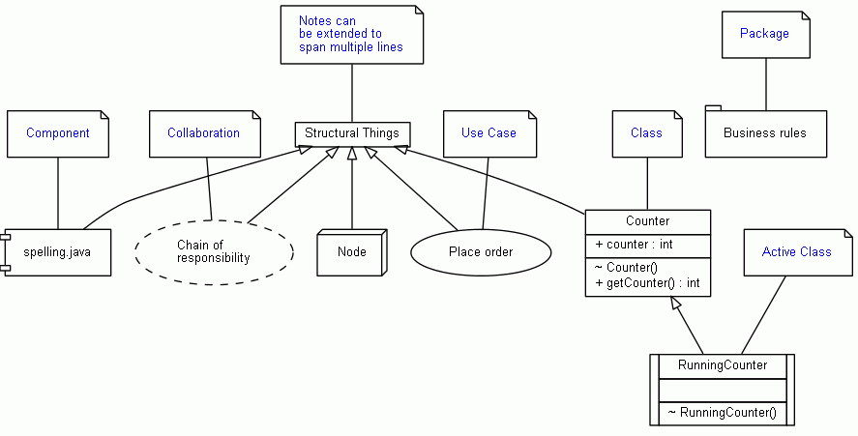
Classifiers…
Date: September 18, 2024
Software Engineering Design: Theory and Practice

Slide 12
Relationships apply to all UML Classifiers. UML relationships include:
Dependency | Dashed line (typically directed with a stick arrow) used to model the relationship between two UML classifiers indicating that changes to one element affect the other.
Association | Line used to model the relationship between two UML classifiers indicating that a connection exists between them; associations can be directed using a stick arrow.
Generalization | Line with a hollow arrowhead used to model the relationship between two UML classifiers indicating that one (child) inherits from another (parent).
Realization | Relationship between two UML classifiers indicating that one element realizes a specified interface; modeled using a dashed line with hollow arrowhead.
Date: September 18, 2024
Software Engineering Design: Theory and Practice

Slide 13




Common UML mechanisms for enhancement:
Notes
  Mechanism for adding descriptive information to UML elements (both classifiers and relationships) and diagrams; modeled using a rectangle with a dog-eared corner and can be connected using a dashed line.
Stereotypes
  Mechanism for extending UML by adding information that gives existing UML elements (both classifiers and relationships) a different meaning, therefore creating a semantically different element for modeling application-specific concepts; modeled as existing UML elements with the <<stereotype>> mechanism.
Contains algorithms
for clustering, classification, and numeric prediction.
<<component>>
Analytics
UML Note
<<subsystem>>
SensorManager
<<client>>
CollectionSystem
<<server>>
DataProcessor
<<utility>>
FileUtility
Stereotyped Components
Stereotyped Class
Date: September 18, 2024
Software Engineering Design: Theory and Practice

Slide 14
Common UML mechanisms for enhancement (continued):
Tagged values
  Mechanism for adding new properties to a stereotype; modeled by adding the tagged value in the form of property = value to existing stereotyped UML elements.
Constraints
  Mechanism for specifying constraints to design elements (both classifiers and relationships); associated with specific design elements in the form of
{constraint description}
<<process>>
CollectionManager
location = client laptop
Tagged value to specify location
Constraint
Constraint
{secure line}
TaskMonitor
{monitor time == 1 sec.}
Client
Server
Date: September 18, 2024
Software Engineering Design: Theory and Practice

Slide 15

PROBLEM SOLVING DURING ARCHITECTURE
For example, we will reuse our home-grown class
Other project related constraints
framework to leverage our expertise and develop faster!
Schedule Constraints, Cost Constraints, Quality Constraints
Another example, we will buy and integrate xyz library into our product instead of developing it ourselves
These define the problem
and product constraints
Requirements, System Goals, Scenarios
Evaluate Constraints
Document
Architectural Designs,
Documentation
Interpret Problem
Collaborative Brainstorming
Evaluate
Architectural Design
Controls Examples:
Design reviews must be scheduled with one week of anticipation
Software Quality Assurance personnel must be present during review.
Review of material containing classified information must occur inside a vault
Unfortunately, these are rarely complete on the first shot!
Resources
Activities
Controls
Development team, modeling software, IDEs, hardware, etc.
Tasks performed to process the requirements Example: Design Review
These dictate how, when, and where activities are performed!
Date: September 18, 2024
Software Engineering Design: Theory and Practice
Notes:
"Internal properties of the organization" are factors within the organization, like policies, resources, or culture, that set limits on how solutions can be developed or implemented.

Slide 16
DESIGNING THE ARCHITECTURE
As discussed before, designing architectures require the selection of particular perspectives for design that are appropriate for describing the system to be developed.
  To this end, several model have been created that suggest popular views that are useful in the design of most systems.
  These models propose addressing the system’s architectural design from perspectives that are common to most software systems.
  They provide a systematic and disciplined approach to architecture creation.
  Two popular models are
    The 4+1 view model
    Siemens’ 4 views model
Date: September 18, 2024
Software Engineering Design: Theory and Practice

Slide 17
THE 4+1 VIEW MODEL
View: Representation of a system from a particular perspective.
  It is impossible to represent all relevant information about a system’s architecture in a single architectural model, as each model only shows one view or perspective of the system.
  You usually need to present multiple views of the software architecture
  Multiple perspective are necessary to capture the complete behavior and development of a software system.
Designed by: | Philippe Kruchten
Designed for: | Describing the architecture of software-intensive systems, based on the use of multiple, concurrent views
Date: September 18, 2024
Software Engineering Design: Theory and Practice

Slide 18



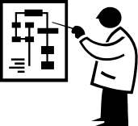

The 4+1 view model is a software architecture framework that describes the five different perspectives or views that are used to describe a system. These five views are:
End user
Logical view
Development
view
Programmers
& software
managers
Scenarios
Process View
Physical View
Integrator
System Engineer
This model is a way of understanding the key considerations or important perspectives that need to be addressed in software architecture.
Date: September 18, 2024
Software Engineering Design: Theory and Practice

Slide 19
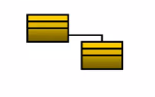
Logical (or Structural) = Object-oriented Decomposition
This view describes the system’s functionality from a logical or business perspective.
Viewer | End-user
Considers | Functional requirements: What the system should provide in terms of services to its users.
This view shows the components (objects) of the system as well as their interactions/relationships.
UML diagrams: Class, State Machine, Object, Composite Structure
Date: September 18, 2024
Software Engineering Design: Theory and Practice
Notes:
Class Diagram and State Diagram

Slide 20

Process (or Behavioral) = The Process Decomposition
This view describes the system’s functionality from a process or operational perspective.
Viewer | Integrators
Considers | Non - functional requirements (concurrency, performance, usability, scalability etc.)
This view shows the processes (workflow rules) of the system and how those processes communicate with each other.
UML diagrams: Activity, Sequence, Interaction Over diagrams
Date: September 18, 2024
Software Engineering Design: Theory and Practice
Notes:
The Process Decomposition
Shows how, at run time, the system is composed of interacting processes.

Slide 21

Development (or Implementation) = The Sub-system Decomposition
This view describes the system’s functionality from an implementation or technical perspective.
Viewer | Programmers and Software Managers
Considers | Software module organization (Hierarchy of layers, software management, reuse, constraints of tools)
This view shows the building block/view of the system.
UML diagrams: Component, Package diagrams Package details, Execution environments, Class libraries, Layers, Sub-system utilized
Date: September 18, 2024
Software Engineering Design: Theory and Practice
Notes:
The Process Decomposition
Shows how, at run time, the system is composed of interacting processes.

Slide 22
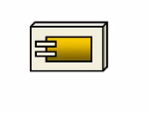
Physical (or Deployment) = Software to Hardware Mapping
This view describes the system’s functionality from a deployment or infrastructure perspective.
Viewer | System Engineers
Considers | Non-Functional Requirements for Hardware (Topology, Communication)
This view shows the system execution environment.
UML diagrams: Deployment diagrams
Date: September 18, 2024
Software Engineering Design: Theory and Practice
Notes:
The Process Decomposition
Shows how, at run time, the system is composed of interacting processes.

Slide 23
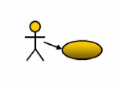
Scenario / Use Case View = Putting it all together
This view describes the system’s functionality from the perspective of the end user.
Viewer | All users of other views and Evaluators
Considers | System consistency, validity
This view shows the Validation and Illustration of system completeness. This view is redundant with other views.
UML diagrams: Use case diagrams, User stories
Date: September 18, 2024
Software Engineering Design: Theory and Practice
Notes:
The Process Decomposition
Shows how, at run time, the system is composed of interacting processes.

Slide 24
Why it is called the 4+1 instead of just 5?
The Use-case View: The use case view has a special significance.
Views are effectively redundant (i.e. Views are interconnected).
  However, all other views would not be possible without use case view.
  It details the high levels requirements of the system.
  The other views detail how those requirements are realized.
Date: September 18, 2024
Software Engineering Design: Theory and Practice

Slide 25
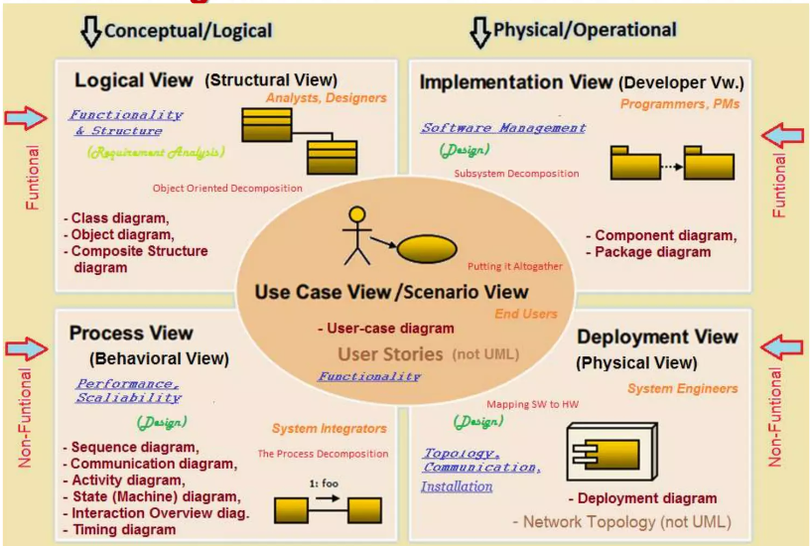
Date: September 18, 2024
Software Engineering Design: Theory and Practice

Slide 26
Thank You...
Mr. Ahsan Arif
Lecturer (Dept. of Software Engineering)
ahsanarif.se42@gmail.com

